Slide 1
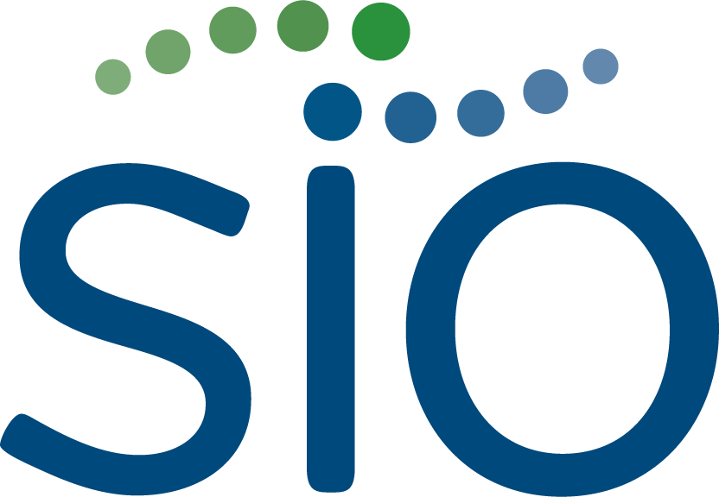
Case of the Month
Getting our patients to the OR: Immunologic LRT downstaging
Claudia Silver, BS, Florida State University College of Medicine
Cynthia De la Garza Ramos, MD, Integrated IR Resident, Mayo Clinic Florida
Beau B. Toskich, MD, Professor of Radiology, Mayo Clinic Florida

Slide 2
Background
Patients with metastatic hepatocellular carcinoma (HCC) often have a poor prognosis with a five-year survival rate of 2%.
Anti-programmed cell death-1 (PD-1) ligand-1 (atezolizumab) and anti-vascular endothelial growth factor (VEGF) (bevacizumab) are considered standard-of-care, first-line, systemic agents for advanced HCC, yet yield a 27.3% overall response rate and 13.9-month survival rate in patients with a baseline AFP ≥ 400 ng/mL.
Re-challenging HCC with alternate immunotherapy regimens and local therapy after initial immunotherapy failure is not well understood.
Combination therapies may potentially offer additive or synergistic effects that could benefit patients with challenging disease presentations.

Slide 3
Clinical Presentation
55-year-old female
MASLD without cirrhosis
Minimal dyslipidemia
ALBI 1, CPA
ECOG 0
Incidentally discovered 15 cm right hepatic lobe HCC with right renal invasion
AFP 169,343 ng/mL
Initial T1-weighted post-contrast MRI demonstrated a 15 cm centrally necrotic right hepatic lobe HCC with extrahepatic spread.

Slide 4
How would you treat this lesion?
Systemic therapy
Resection
SBRT
Y90
TACE
Histotripsy
Combination
Following a multidisciplinary evaluation at a tumor board, the patient was referred to Interventional Radiology to assess her candidacy for neoadjuvant radiation lobectomy as a means of downstaging to surgical resection.

Slide 5
Lung shunt is 25%, cannot get to 205 GY
Planar scintigraphy after initial mapping with 99Tc-MAA demonstrated substantial radiotracer uptake within the liver as well as the lungs. The calculated LSF was 25%. Green: Liver. Blue: Lung.

Slide 6
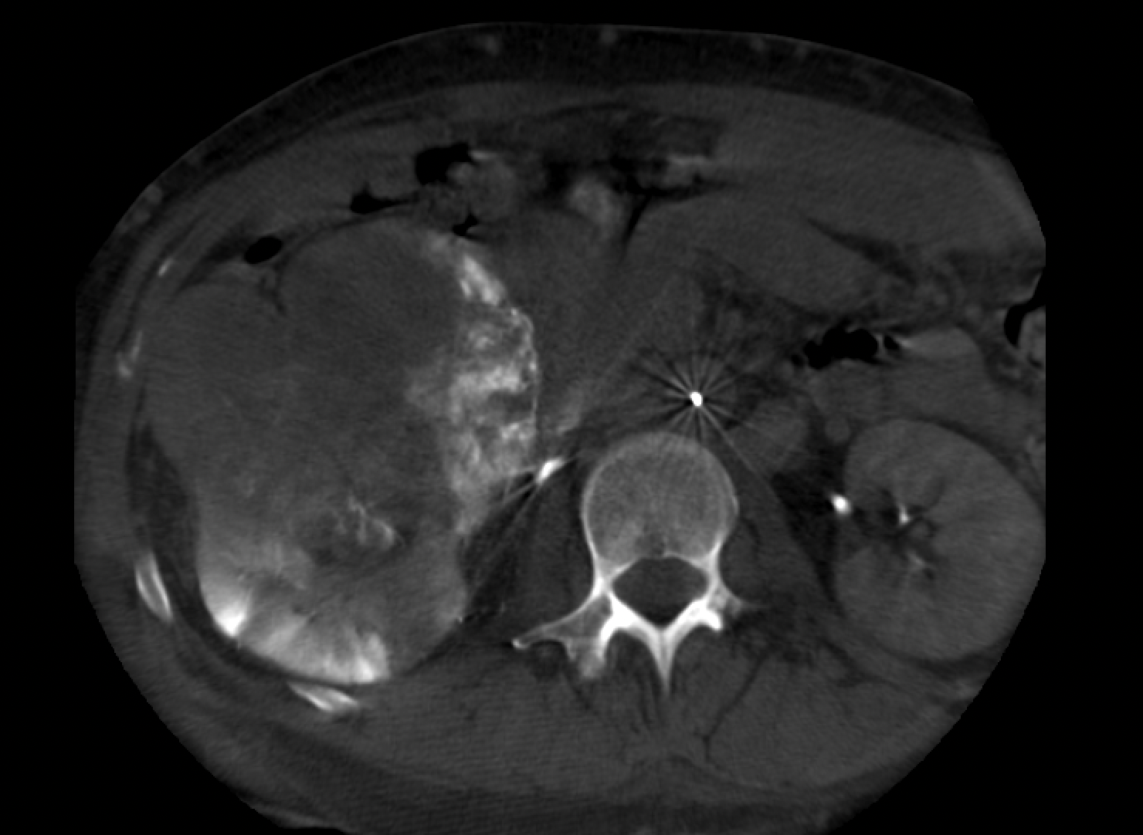
Right renal artery cone beam CT

Slide 7
Patient was treated with palliative atezolizumab-bevacizumab for 6 months
AFP increased to 448,900 ng/mL
Tumor increased to 19 cm and invaded the IVC
ECOG deteriorated to 2
Patient losing weight…

Slide 8
Given disease progression, the decision was made to rechallenge the patient with an alternate immunotherapy and administer a palliative dose of radioembolization
Five days after initiating ipilimumab and nivolumab, the patient underwent radioembolization with a right lobar tumor multicompartment dose of 42 Gy dose (second week 20 Gbq vial) using Yttrium-90 (Y90)-containing glass microspheres (Therasphere, Boston Scientific, Malborough, MA) with 9-day decay.
The estimated lung dose was 19 Gy.

Slide 9
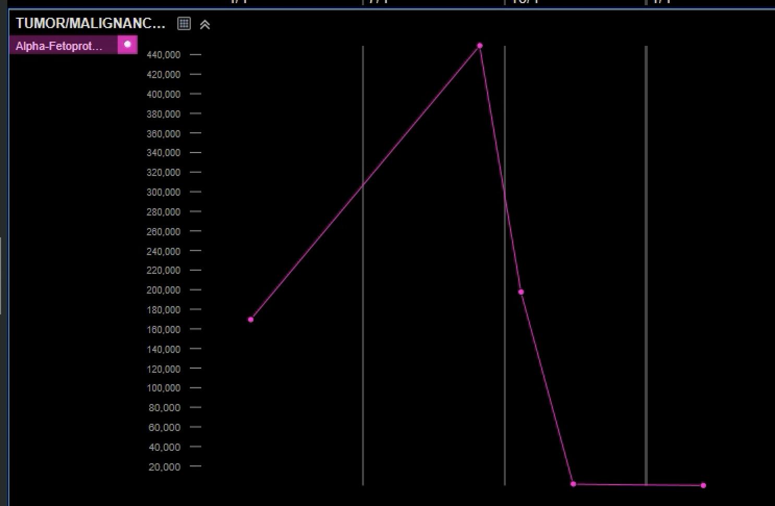
4 months later…
AFP decreased to 64 ng/mL and the patient’s performance improved to ECOG 0
T1-weighted post-contrast MRI four months after combination therapy demonstrated positive treatment response with tumor now decreased in size with a maximum diameter of 11.5 cm and no residual concerning enhancement within the mass.

Slide 10
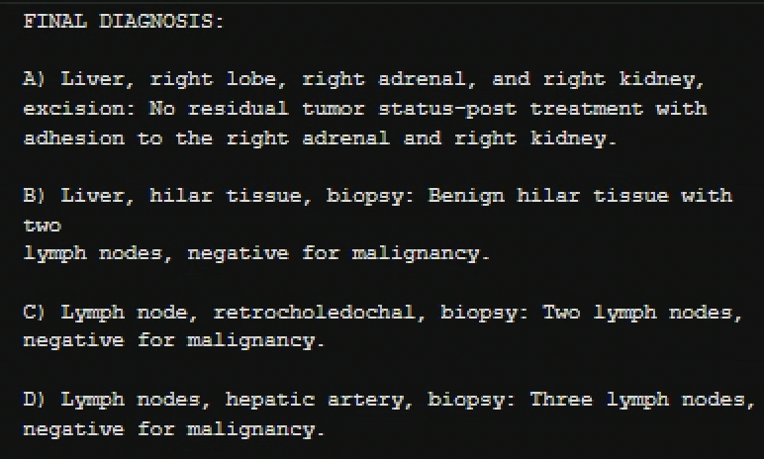
Patient underwent successful en-bloc right hepatectomy, nephrectomy, and adrenalectomy with local lymph node resection 5 months later

Slide 11
The patient remains on maintenance nivolumab and has had no evidence of disease recurrence 16 months after resection
ECOG 0
AFP is normal
Has has minor elevation in creatinine which is medically managed
Most recent follow-up T1-weighted post-contrast MRI obtained 16 months after en-bloc resection demonstrates complete response without evidence of residual or recurrent disease.

Slide 12
Discussion
In the presented case, a patient with HCC with macrovascular invasion and extrahepatic spread that progressed on first-line atezolizumab and bevacizumab was successfully downstaged to surgical resection with a combination of ipilimumab and nivolumab plus radioembolization.
The patient’s disease burden at the time of progression was characterized by a high AFP, which decreased from 448,900 ng/mL to 64 ng/mL four months after initiating this combination regimen and later normalized to 1.0 ng/mL after resection.
The patient did not experience major treatment-related adverse events and is currently without evidence of disease.
This case illustrates the potential for downstaging advanced patients to curative intent treatments using a combination of local therapy and immunotherapy.

Slide 13
Conclusion
While systemic therapy for advanced HCC has shown significant improvement, most patients ultimately progress after first-line regimens.
Little is known about salvaging initial immunotherapy non-responders with an alternative combination of immunotherapy and local therapy.
The combination of immunotherapy and radioembolization in this population warrants further investigation.

Slide 14
References
Nagaraju GP, Dariya B, Kasa P, Peela S, El-Rayes BF. Epigenetics in hepatocellular carcinoma. Semin Cancer Biol. 2022;86(Pt 3):622-32.
Leowattana W, Leowattana T, Leowattana P. Systemic treatment for unresectable hepatocellular carcinoma. World J Gastroenterol. 2023;29(10):1551-68.
Cheng AL, Qin S, Ikeda M, Galle PR, Ducreux M, Kim TY, et al. Updated efficacy and safety data from IMbrave150: Atezolizumab plus bevacizumab vs. sorafenib for unresectable hepatocellular carcinoma. J Hepatol. 2022;76(4):862-73.
Alden SL, Lim M, Kao C, Shu D, Singal AG, Noonan A, et al. Salvage Ipilimumab plus Nivolumab after Anti-PD-1/PD-L1 Therapy in Advanced Hepatocellular Carcinoma. Cancer Res Commun. 2023;3(7):1312-7.
Yeo YH, Liang J, Lauzon M, Luu M, Noureddin M, Ayoub W, et al. Immunotherapy and Transarterial Radioembolization Combination Treatment for Advanced Hepatocellular Carcinoma. Am J Gastroenterol. 2023;118(12):2201-11.
Garin E, Tselikas L, Guiu B, Chalaye J, Edeline J, de Baere T, et al. Personalised versus standard dosimetry approach of selective internal radiation therapy in patients with locally advanced hepatocellular carcinoma (DOSISPHERE-01): a randomised, multicentre, open-label phase 2 trial. Lancet Gastroenterol Hepatol. 2021;6(1):17-29.
Ouranos K, Chatziioannou A, Goulis I, Sinakos E. Role of immunotherapy in downsizing hepatocellular carcinoma prior to liver transplantation. World J Transplant. 2022;12(11):331-46.
Lu Q, Yan W, Zhu A, Tubin S, Mourad WF, Yang J. Combining spatially fractionated radiation therapy (SFRT) and immunotherapy opens new rays of hope for enhancing therapeutic ratio. Clin Transl Radiat Oncol. 2024;44:100691.
Finn RS, Ryoo B, Hsu C, Li D, Burgoyne A, Cotter C, et al. Results from the MORPHEUS-liver study: Phase Ib/II randomized evaluation of tiragolumab (tira) in combination with atezolizumab (atezo) and bevacizumab (bev) in patients with unresectable, locally advanced or metastatic hepatocellular carcinoma (uHCC). 2023 ASCO Annual Meeting I; May 31. Journal of Clinical Oncology: ASCO Publications; 2023.

